Slide 1
Continual Learning: NER

Slide 2
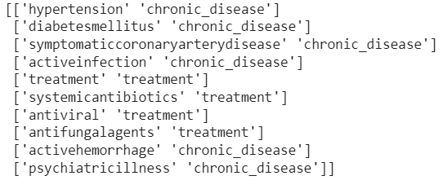
Preprocessing
Stage 0
Stage 1
Tags as a list of tuples

Slide 3
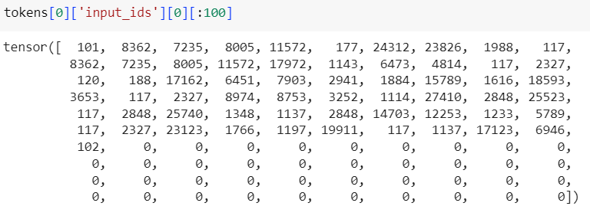
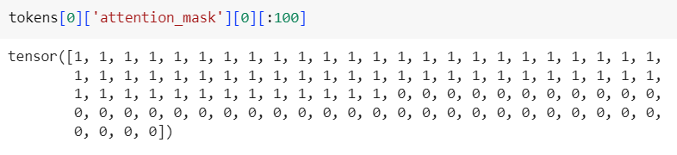
Stage 2
Tokenized Input Ids
Tokenized Attention Mask
Decoded Tokens
Word Ids

Slide 4
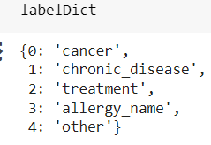
Stage 3
Decoded Words
Stage 4
Labelled Words
Stage 5
Token Labels
Label Dict

Slide 5
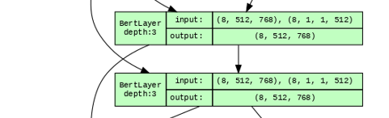
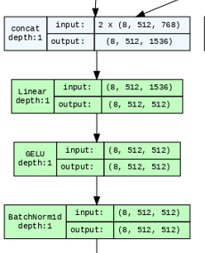
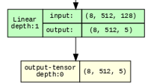
Model
BERT (10 Layers)
https://huggingface.co/emilyalsentzer/Bio_ClinicalBERT
Dense Layers

Slide 6
Results
Base-BioBert+ANN (Without Freezing) | Performance on Test Set of T1 | Performance on Test Set of T1, T2 | Performance on Test Set of T1,T2 and T2 | Performance on Test Set of G1+G2+G3
F1 Treatment | 0.882 | 0.87 | 0.86 | 0.856
F1 Cancer | 0.852 | 0.866 | 0.881 | 0.877
F1 Allergy | 0.868 | 0.845 | 0.8223 | 0.8162
F1 Chronic Disease | 0.88 | 0.875 | 0.8821 | 0.875
F1 Other | 0.936 | 0.9311 | 0.9299 | 0.932
F1 Weighted | 0.915 | 0.909 | 0.907 | 0.907

